Slide 1
What is Esports?
By Louie Kift only images

Slide 2
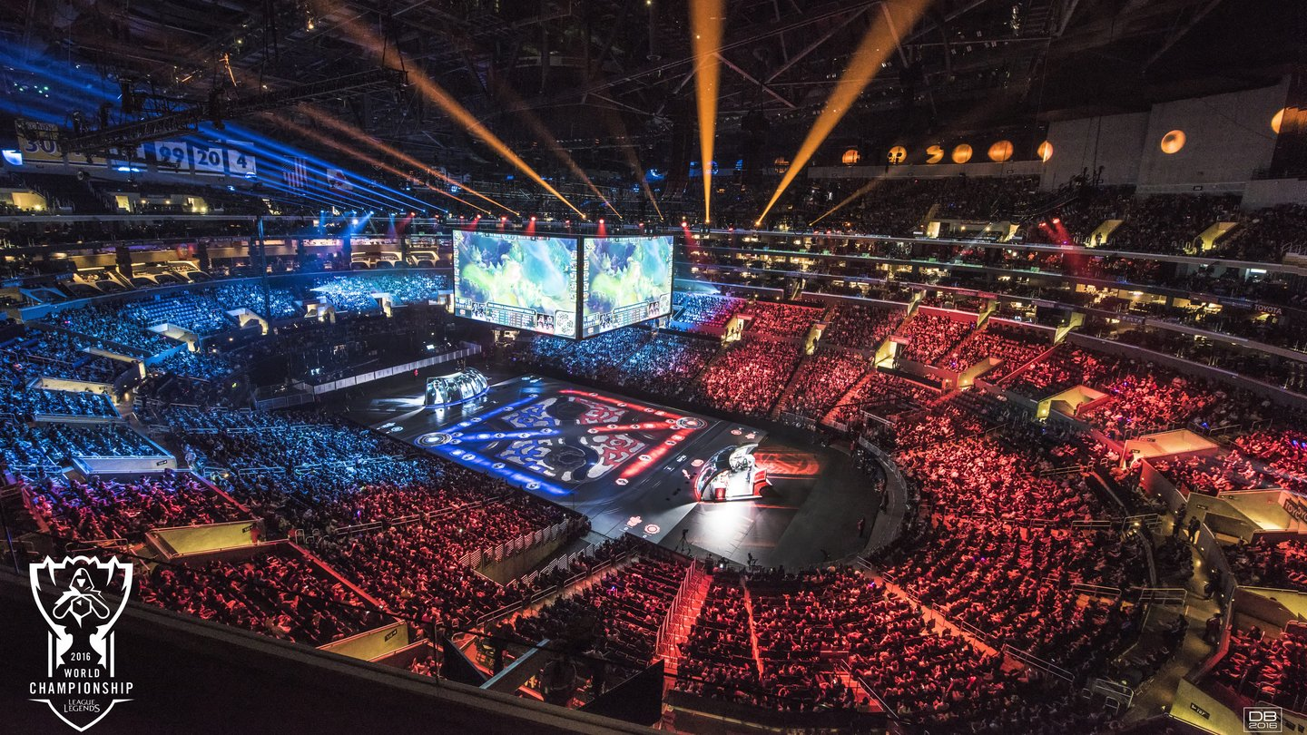

What is Esports?
Riot Games, 2018
esportsedition, 2017
Notes:
What is Esports? CNN defines Esports as “the world of competitive, organized video gaming. Competitors from different leagues or teams face off in the same games that are popular with at-home gamers: Fortnite, League of Legends, Counter-Strike, Call of Duty, Overwatch and Madden NFL, to name a few.” (AJ Willingham, 2020)
“These gamers are watched and followed by millions of fans all over the world, who attend live events or tune in on TV or online. Streaming services like Twitch allow viewers to watch as their favorite gamers play in real time, and this is typically where popular gamers build up their fandoms.” (AJ Willingham, 2020)
This is an accurate overview of what Esports is. In addition, this report covers aspects from how funding works to how player rates are calculated, and where a lot of the income comes from for organizations running teams.

Slide 3

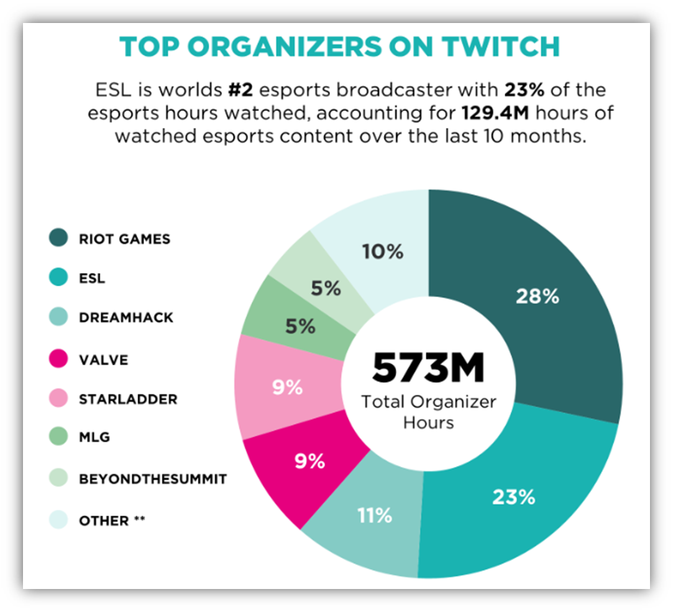

Esports Organisers
Toornament.com, 2019
Martechtoday.com, 2019
NewZoo Esports, 2016

Slide 4


The History of Esports
Image of Spacewar on a PDP-1 from the Spacewar Wikipedia.
StarCraft FR, YouTube, 2018

Slide 5


Funding for Esports Organisations
Gamepedia, 2019
Bloomberg, 2019

Slide 6


FaceIt vs ESEA
FaceIt Corporate, 2019
Liquipedia, 2019

Slide 7

Esports Buyouts
Lol Esports, YouTube, 2019

Slide 8


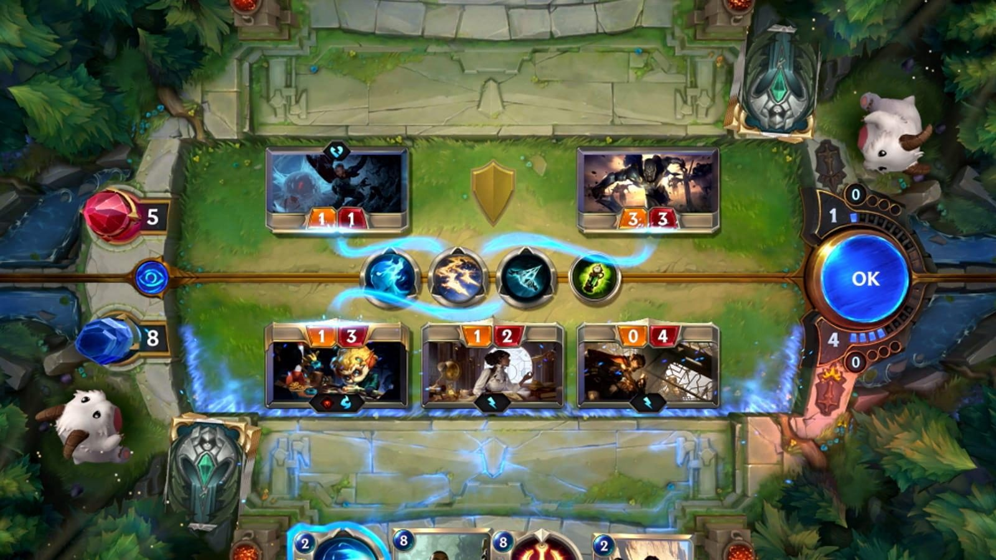
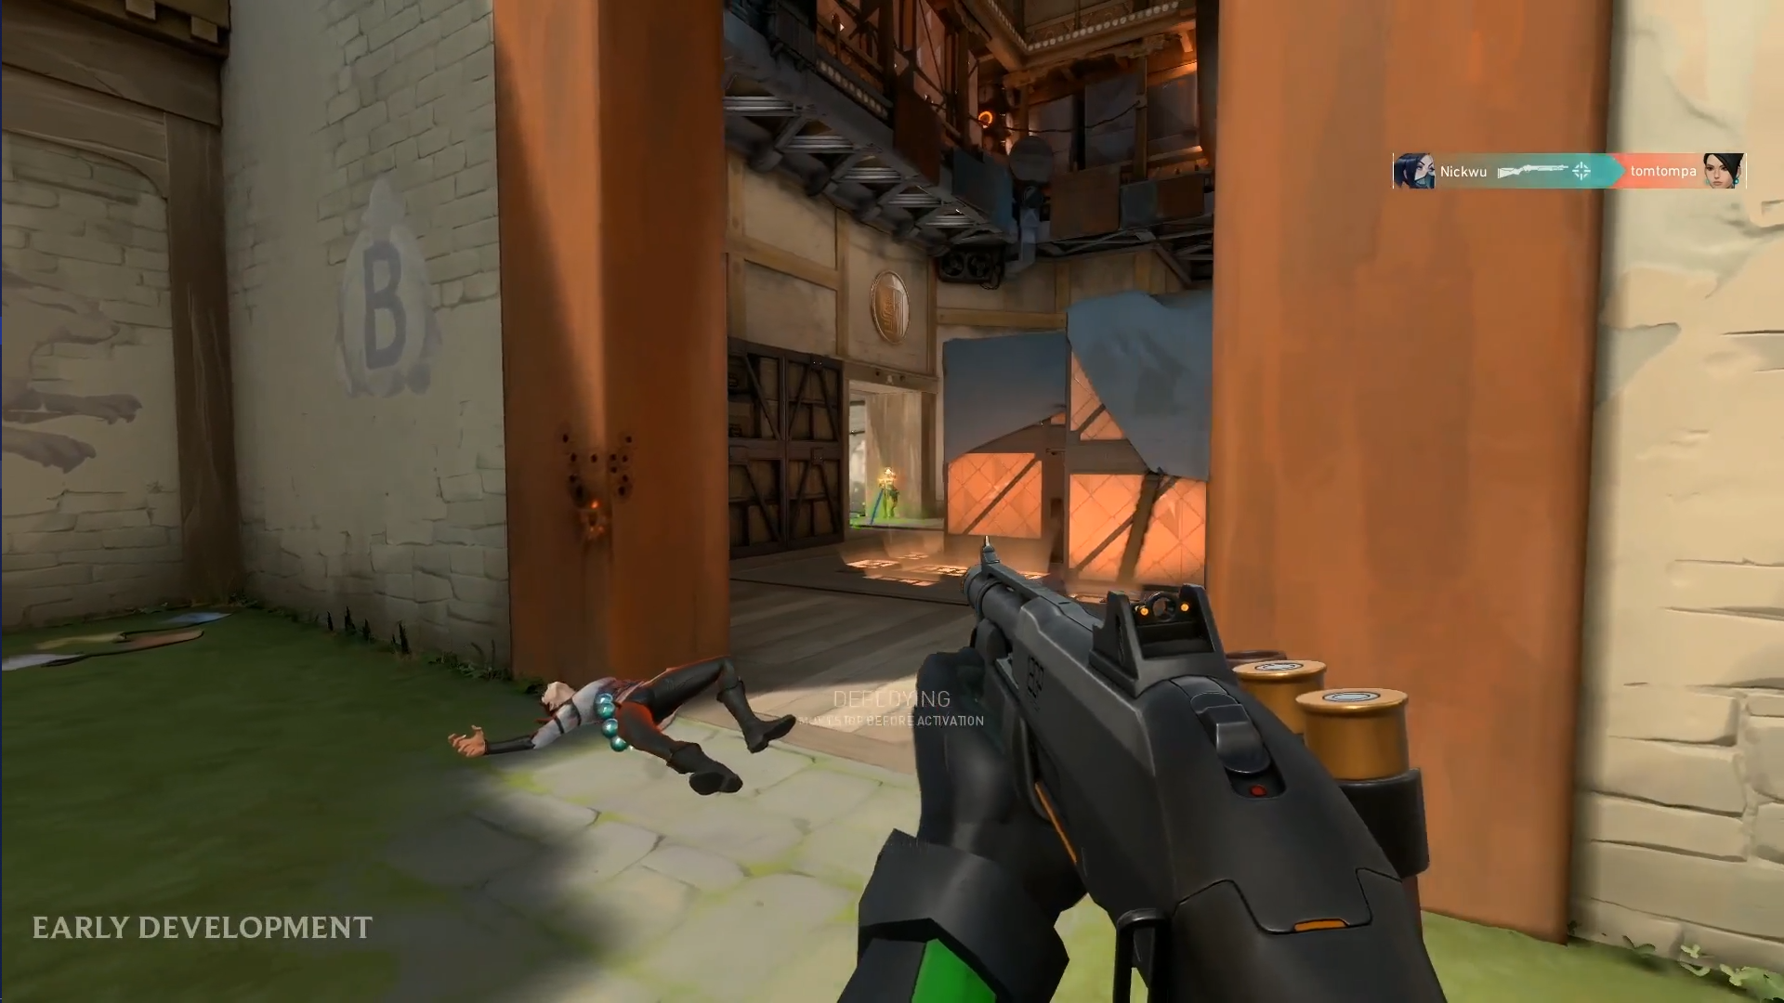
The Future of Esports
PlayOverwatch, YouTube, 2019
ESPN, 2019
Dot Esports, 2019
Dot Esports, 2019

